Slide 1
The Transition Academy: Assistive Career Guidance
Team:
Pvga
Members:
Pavan kumar chongala
Syed Usman gani
Vamsi Draksharam
Anusha Konakalla

Slide 2
INTRODUCTION:
The Transition Academy site fills this void by serving as a one-stop shop resource hub that provides an online listing data of colleges, job, employment training and life skills programs based on the location requierments.

Slide 3
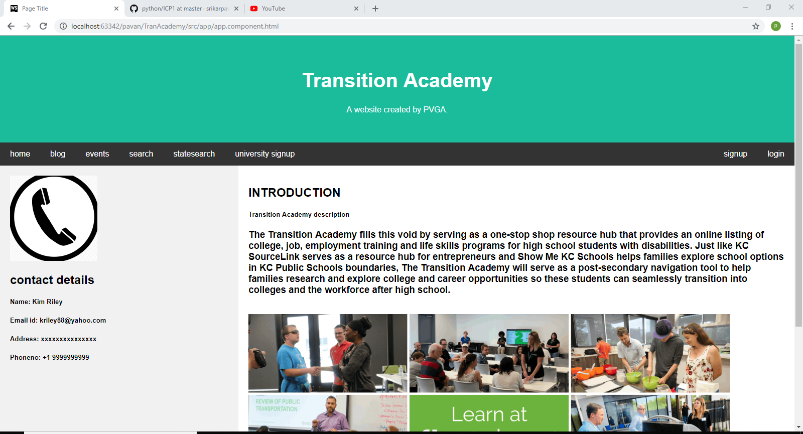

Slide 4
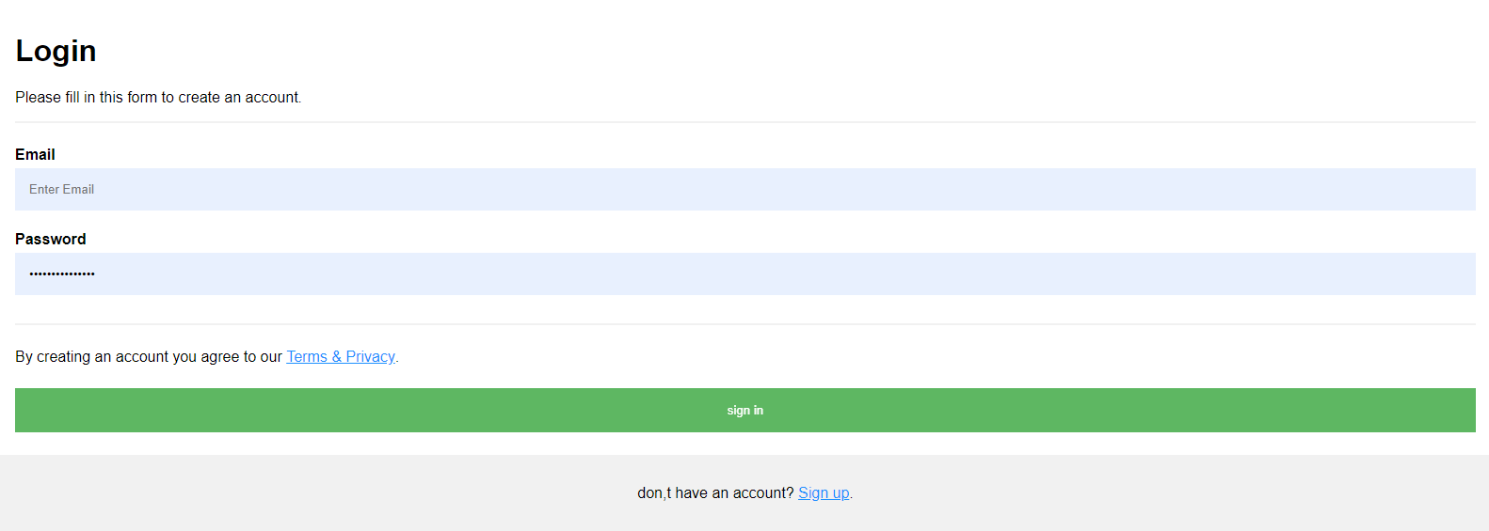
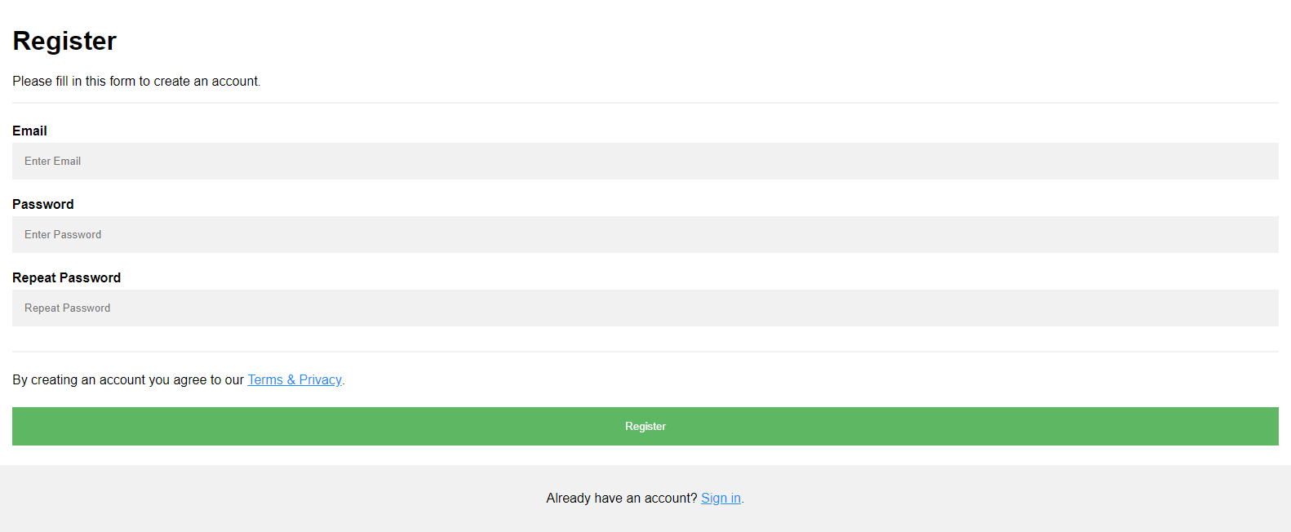
Featured pages:
Homepage
Login page
Signup page
Blog
Zip search
State search
events

Slide 5
Description Of Pages
Homepage : introduction and contact details
Login page: user login
Signup page : registration page
Zip search : search of the college and other details on a certain zip code region
State search : search of the college and other details on a state
Events : events happining

Slide 6
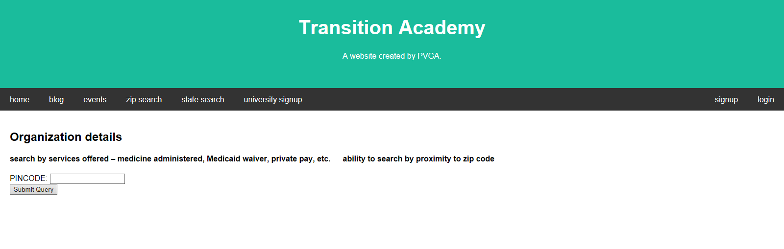
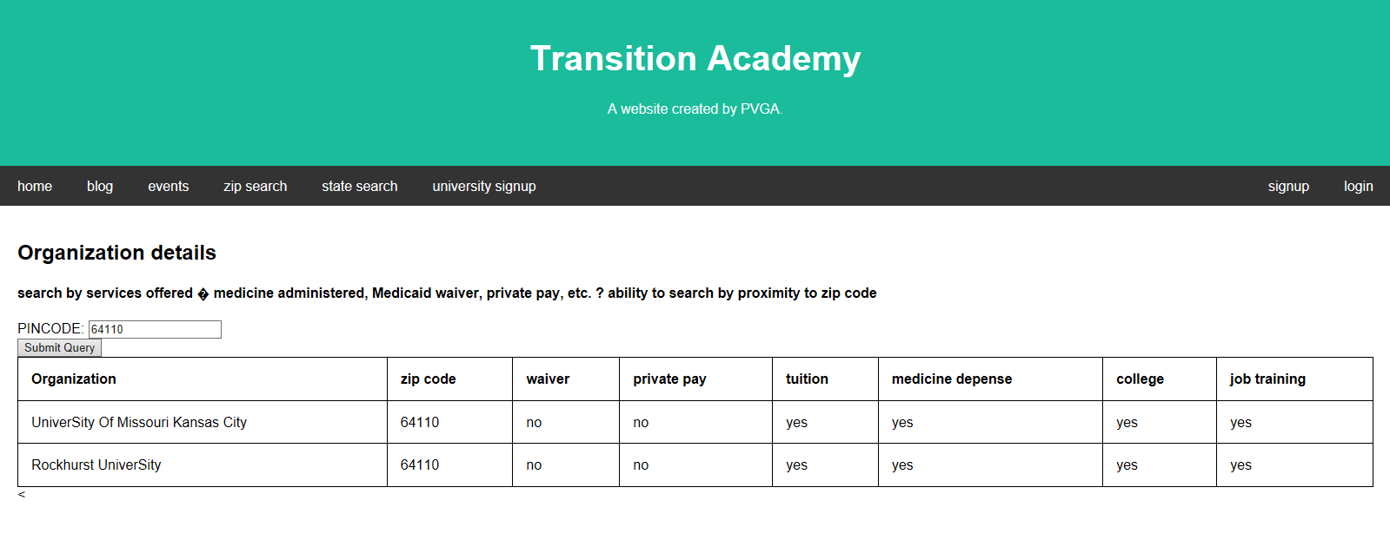

Slide 7
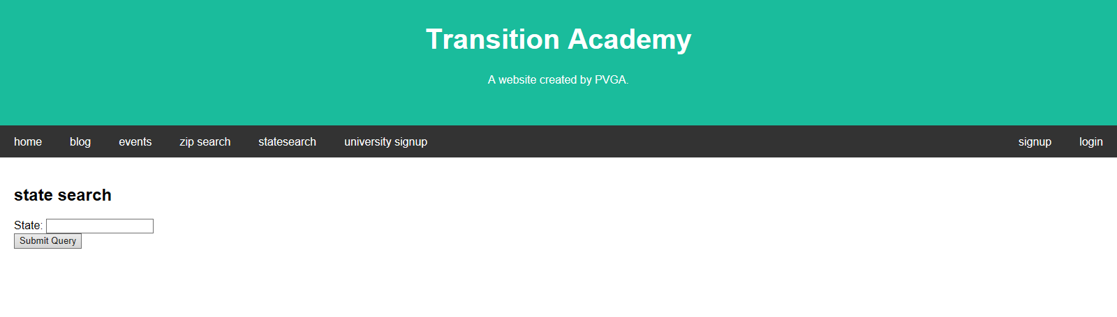
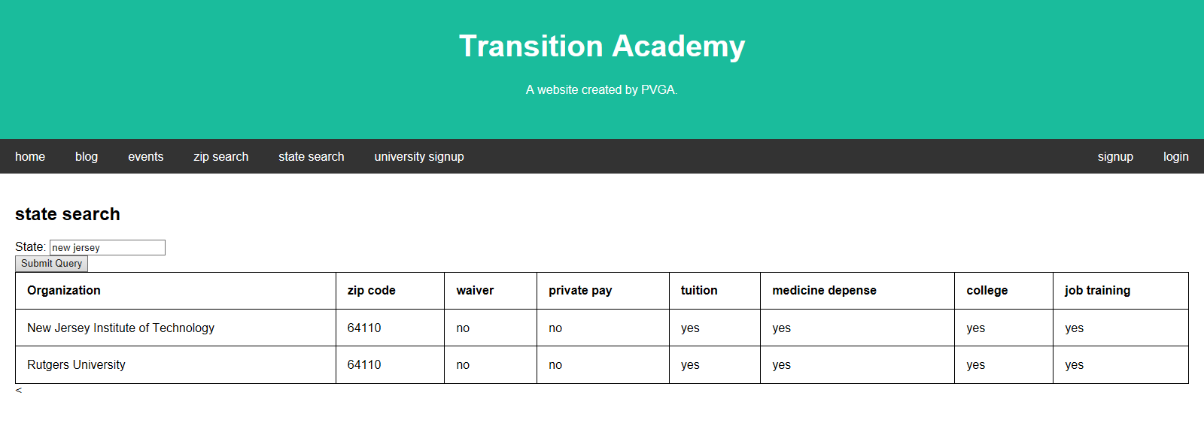

Slide 8
Thank you

